Slide 1
Lorry Parking Issues
Warrendene Road Hughenden
A Petition submitted by local residents to Buckinghamshire Council
Summary of investigations and proposed ideas on a way forward
By Jim Stevens and Jackie Binning

Slide 2
This presentation:
This presentation and the full report have been written by Jim Stevens C.Eng., MICE, MCIHT.
  Jim Stevens is a Charted Engineer, a Volunteer and the current chairman of NWCCB Traffic and Road Issues Action Group
This presentation covers:
The Resident’s Petition
Information gathering
Ideas and evolution of a possible way forward
Recommendations to the Community Board

Slide 3
Approach Adopted to this work:
Independent view of the issues
Listening to all parties – being fair and equal
Objective approach to finding ideas that might ease the problems
Mediating

Slide 4
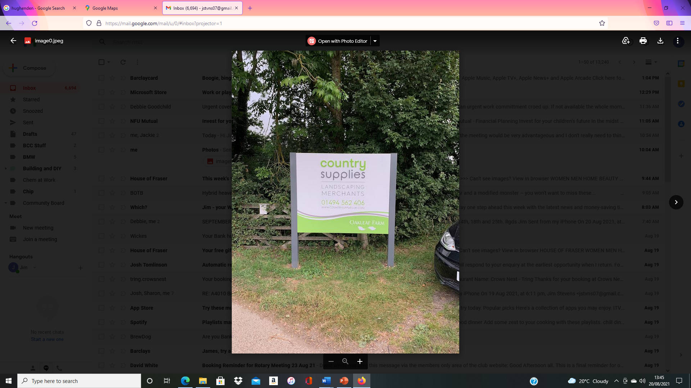
Country Supplies:
Country Supplies operates from Oakleaf Farm in Warrendene Road (and at Shana, Walters Ash).
The business is the ‘Storage and Distribution of Horticulture and Landscaping Supplies’ and was ‘authorised’ in planning terms in 2002 as a result of a Public Inquiry.
The very nature of Country Supplies business operations necessitates daily movement of lorries (their own and third party) to deliver, collect and distribute goods and materials.
Lorry demand on the Oakleaf Farm site often exceeds its physical capacity - the excess demand results in lorry parking on Warrendene Road.
These lorry parking problems have existed for more than 20 years and still remain unresolved.

Slide 5
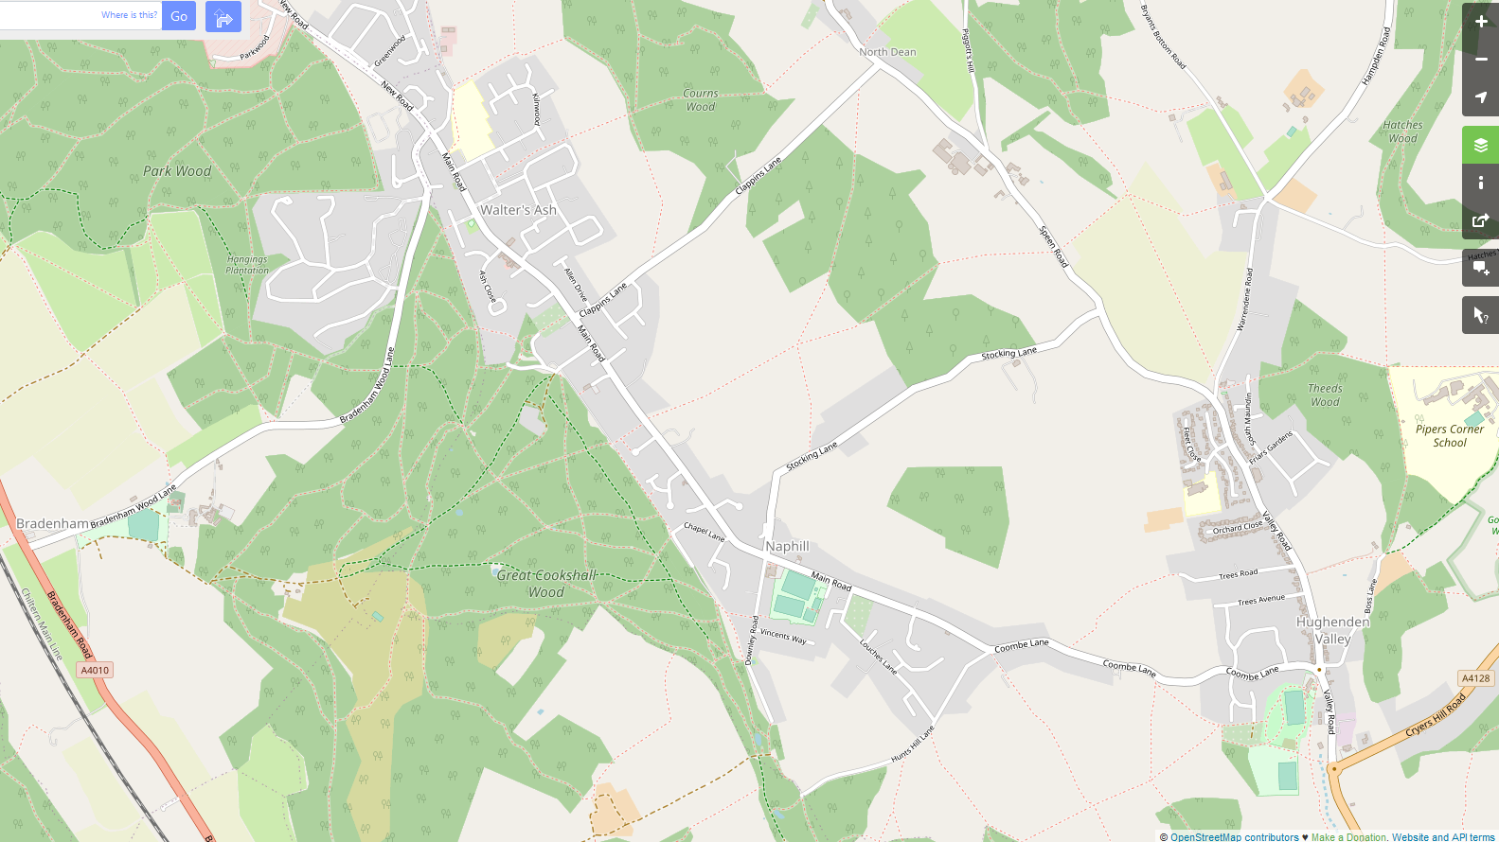
Shana, Walters Ash
Oakleaf Farm
Warrendene Road

Slide 6
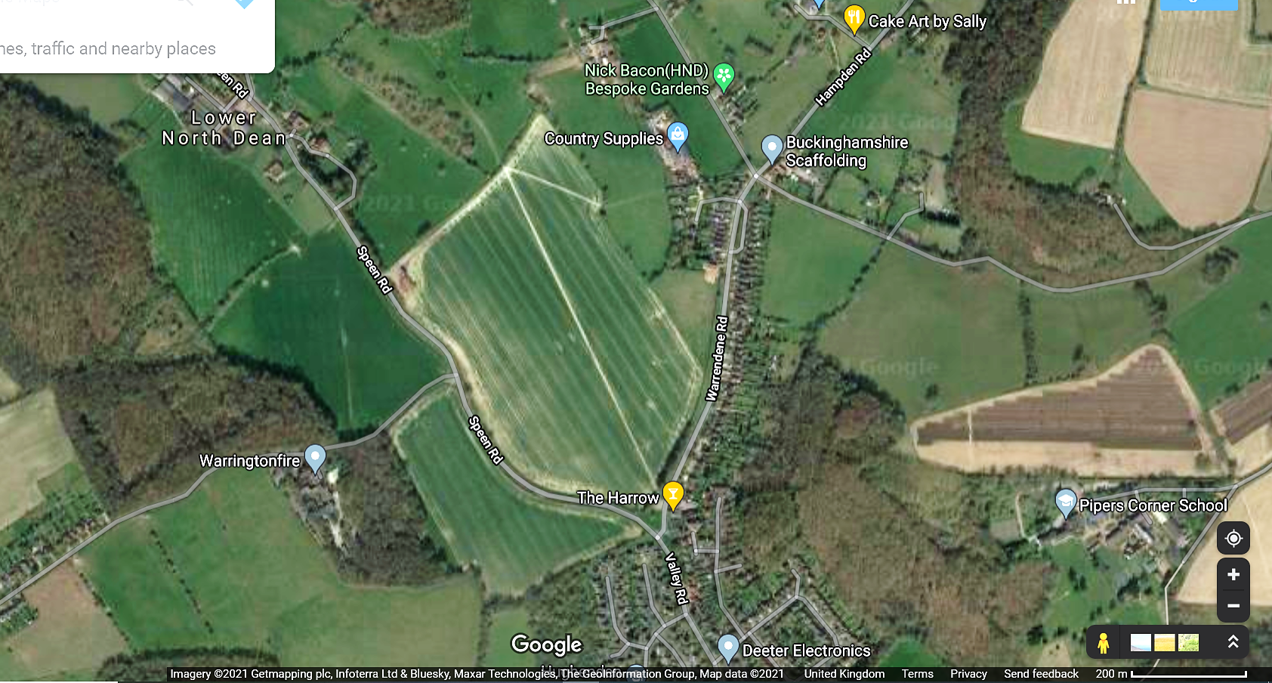
Locations where lorries park in Warrendene Road

Slide 7
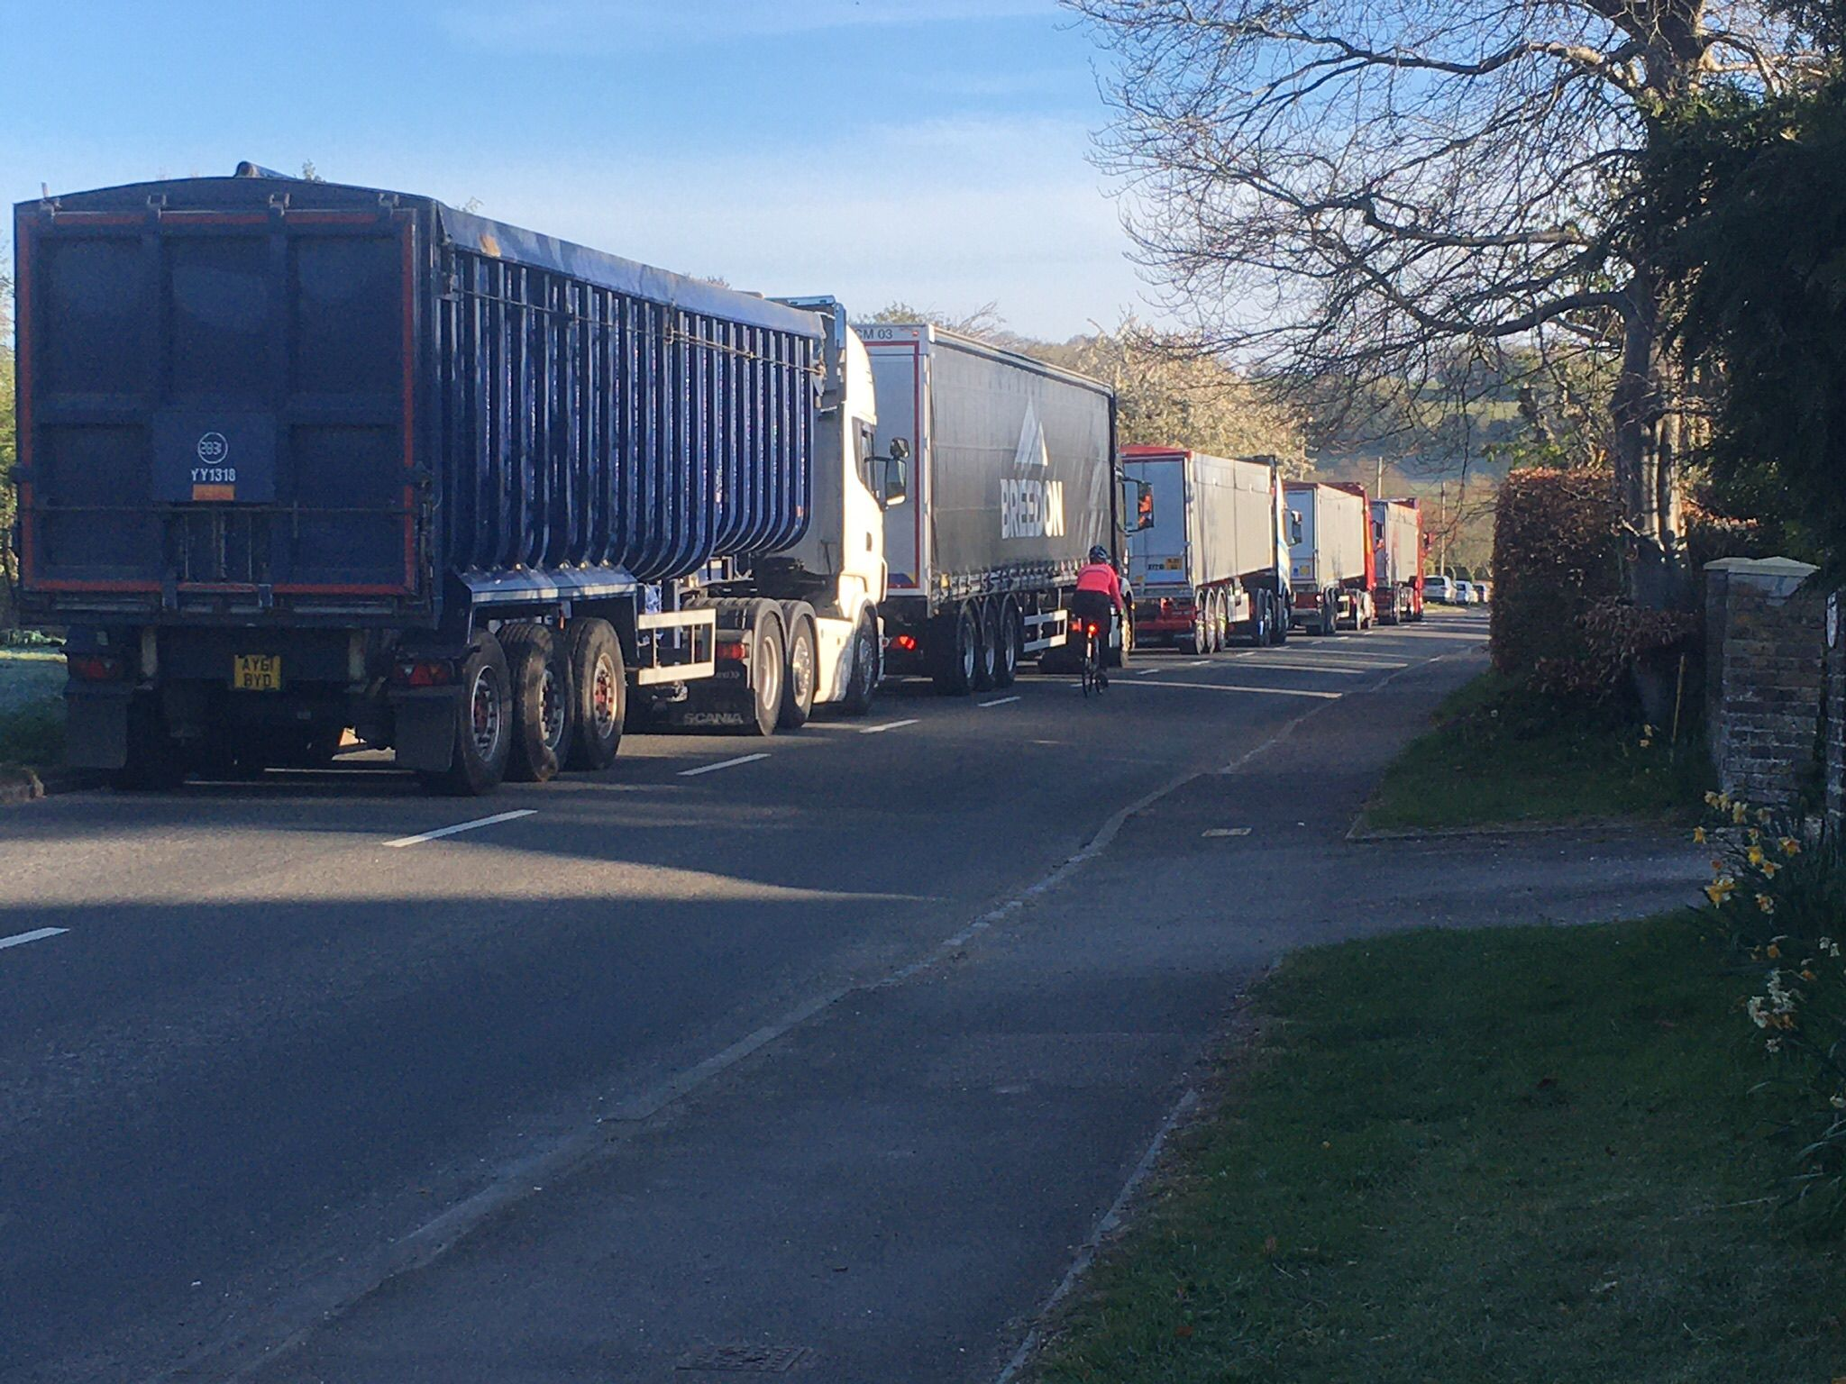
Lorries parking on Warrendene Road

Slide 8
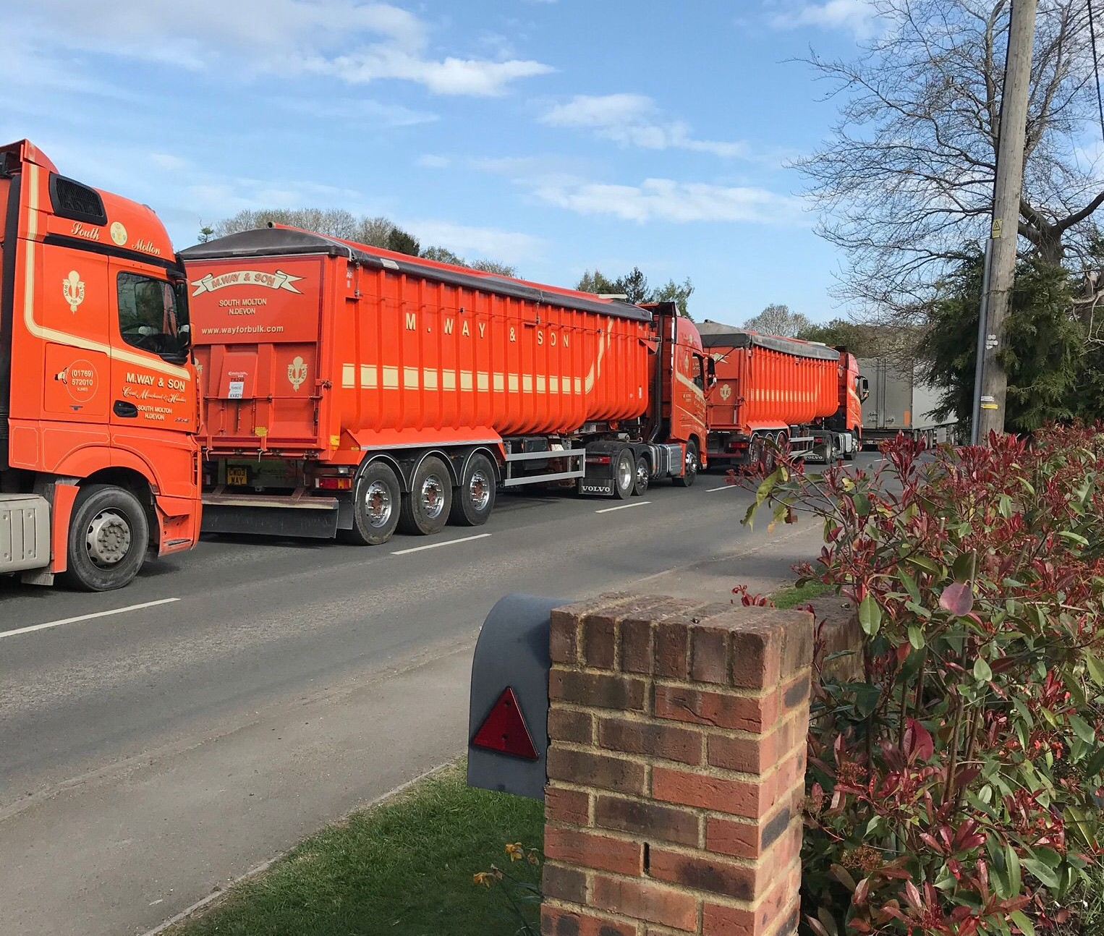
Lorries parking on Warrendene Road

Slide 9
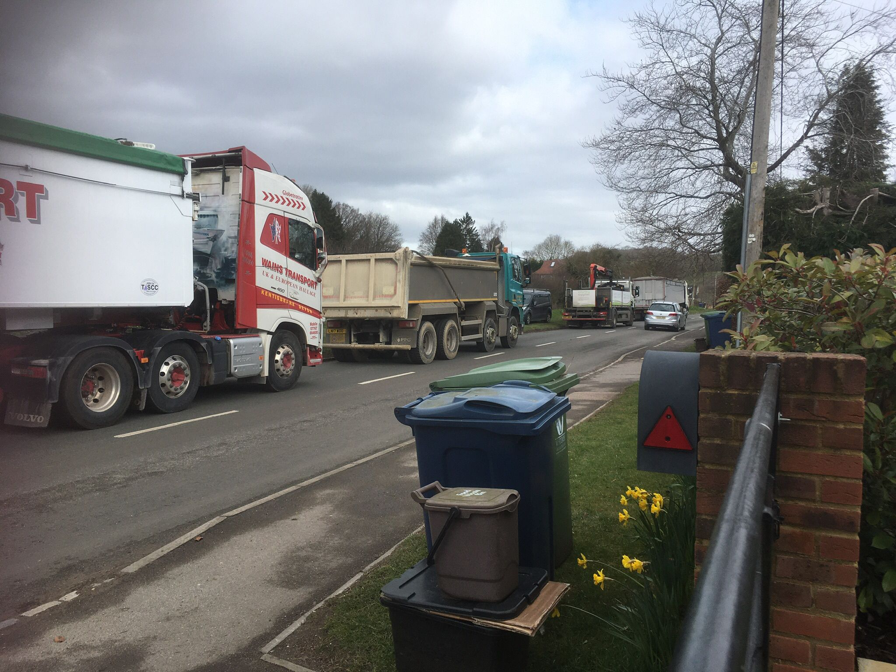
Lorries parking on Warrendene Road

Slide 10
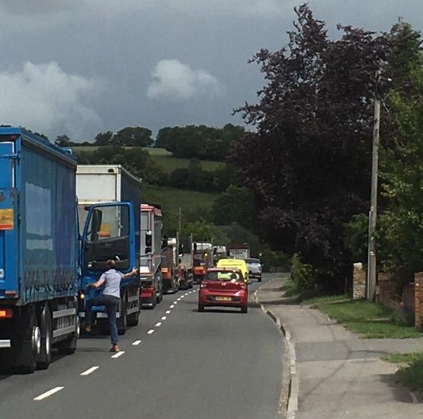
Lorries parking on Warrendene Road

Slide 11
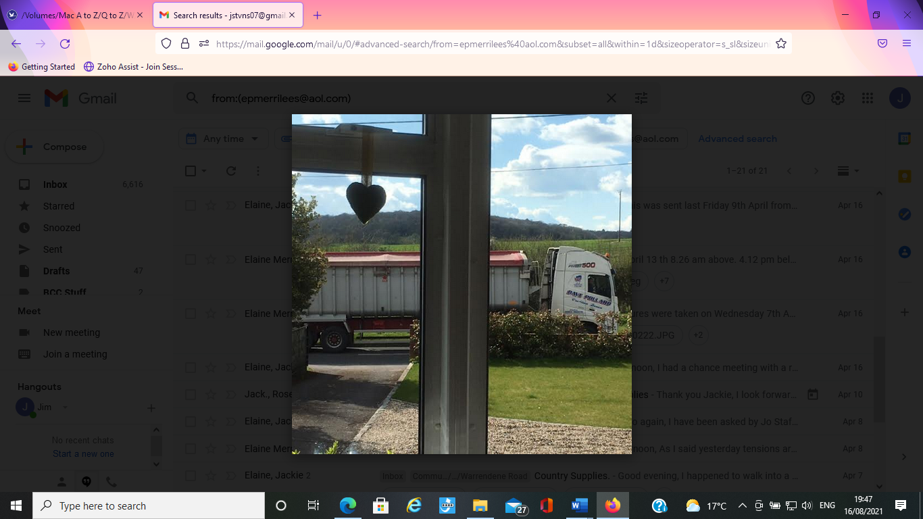
A view from inside a resident’s house

Slide 12
The Resident’s Petition:
Submitted to Buckinghamshire Council - Feb 2021
99 signatures from local area
Extract from Resident’s Petition
“ WE, THE UNDERSIGNED, SUPPORT THIS PETITION THAT SEEKS TO RESOLVE THE ISSUE OF LORRY PARKING IN WARRENDENE ROAD
Accordingly, we would ask that Country Supplies carries out viewings and retail sales only at the Oakleaf Farm site and that all deliveries from their suppliers and their own deliveries are made from the large Shana site at Walters Ash where they have sufficient space on site to accommodate these lorries rather than on the public highway that results in the loss of residential amenity and poses a danger to road users. “

Slide 13

The Resident’s Petition:
Considered by NWC Community Board 11 March 2021:
“ Resolved: The Community Board agreed that further conversations take place with the local business to try and resolve the issue. The council had made initial contact and they had indicated that the local business was keen to meet with local councillors, in order resolve the issue. These discussions would also make sure they were complying with the planning restrictions and operator’s licence in place. Jim Stevens had indicated that he was happy to be leading this with support from council officers. At the same time, the parking services team would draft possible solutions for Highway Code supported waiting and parking restrictions and informal consultation with residents should take place. “
Main parts of the Resolution:
  Discussion with Owner to try and resolve issue.
  Jim Stevens to lead and support from council officers.
  Reference to GVOL and Planning
  Parking Team to draft possible scheme of parking restrictions

Slide 14
Information gathering:
Information gathering:
  Many meetings with:
    The two Resident’s Representatives – March to September 2021
    The Owner of Country Supplies – Also March to September 2021
  Emails / meetings with Hughenden Parish Council Chairman
  Meetings with BC’s Highways, Freight and Parking Officers
  Meetings with two BC local Councilors
  Meeting with Hughenden Valley Residents Association (HVRA)
All virtual meetings - no site visits

Slide 15
Meetings with Residents and the Owner
  Gather information about:
    The resident’s concerns
    The scale of the lorry parking problems
    How Country Supplies organise/manage deliveries/collections
  Discuss:
    The Residents Petition
    Ideas that might solve the problems
  Identify:
  possible solutions to bring back to the Community Board

Slide 16
The Resident’s representatives:
The two lead petitioners (members of HVRA, the road wardens for Warrendene Road and Valley Road
They said:
  the issues have existed for 20+ years and getting worse
  Police, the Council’s, Neighborhood Action Group all involved in the past, but the parking problems continue
  Long list of issues and problems - broadly summarized as follows:
Environmental and amenity impact
  Disturbance, noise and inconvenience for residents
Impact on the AONB and Green Belt
Exhaust emissions from stationary HGV’s
Impact on air quality and health
The road safety risks created for:
  Road users generally
  Residents using their driveways
  Pedestrians walking alongside or crossing Warrendene Road
Obstruction to:
  Resident’s driveways
  Free flow of traffic
  Gridlock when the refuse vehicle collects bins

Slide 17
Resident’s representatives:
  Want to see a sustainable solution implemented
  Are concerned that the Owner of CS does not respond when contacted
  Would like to know:
Why can’t all bulk material deliveries be moved from Oakleaf Farm to the Shana site and the Oakleaf Farm site just used for retail sales and customer deliveries? (as per the Resident’s Petition).
Why doesn’t the Owner schedule the times of delivery for all lorries?
How the owner sees his business operating in 5 years’ time?

Slide 18
Hughenden Parish Council Chairman:
The Parish Council’s Road Safety Working Group and Hughenden Neighbourhood Action Group share the same views, as follows:
Support that residents need a resolution ASAP and the efforts of Local Buckinghamshire Councillors
Strongly support the consultation process with owner of Country Supplies to identify a workable solution
Want to see a comprise solution exhaustively pursued rather than going directly to a broad parking ban
Displacement somewhere else in the Parish should definitely not be seen as a solution
Aware that Country Supplies can control their own vehicles but suspect there will be less influence with their supplier’s route scheduling.
Consider that the installation of parking guidance with white lines and signage or a layby could help.

Slide 19
Enforcement Appeal History
Public Inquiry held in 2002
Appeal against an Enforcement Notice served by Wycombe District Council:
  to seek cessation of the storage and distribution of horticultural and landscaping materials supplies at Oakleaf Farm
Government Planning Inspector upheld the appeal:
  quashed the enforcement notice
  this established, in Planning terms, the Country Supplies Business use of Oakleaf Farm
  No planning conditions were imposed by the Planning Inspector

Slide 20
The Owner’s key messages:
  Is willing to cooperate with the Council and residents to find solutions
  Finding solutions to ease the parking issues is extremely difficult
  The business peaks at Easter and Autumn. This year Easter was exceptional
  Has little or no control over third party lorry deliveries
  Is concerned with the relationship between Country Supplies and residents
    Said he is approachable and does respond to residents, but admits on one occasion he didn’t
  Has trialed two changes to manage lorry access to the site
  Is recruiting a new Transport Manager
  Is willing to consider ideas to improve the situation

Slide 21
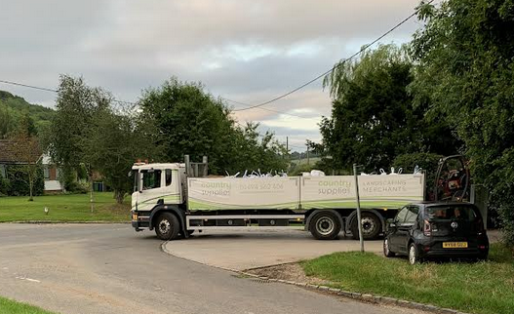
Lorry Demand:
The Owner has said that he has to constantly manage / balance the demand arising from:
  Deliveries of bulk materials by third party lorries.
  Loading of Country Supplies lorries for deliveries to customer sites.
  The transfer of supplies between the Oakleaf Farm and Shana sites.
  Customer collections/purchase (i.e., landscaping contractors, the public).

Slide 22
Owner’s response to the specific issues/questions raised by residents
All bulk material deliveries should be moved from Oakleaf Farm to the Shana site and the Oakleaf Farm site just used for retail sales and customer deliveries. Shana site not big enough - would require expansion. Would intensify Shana operations. Would displace the lorry parking issues to Walters Ash. Ruled out.
Why doesn’t the Owner schedule the times of delivery for all lorries? Owner has little or no control over third party lorries, which constitute 50% of lorries parking on WR. Has trialled changes to lorry access. Is currently recruiting a Transport Manager – who will use logistics management software. This is very positive and an opportunity.
How the owner sees his business operating in 5 years’ time? The Owner may acquire a third site – and this would be in addition to Oakleaf Farm and Shana. The Owner plans to stay at Oakleaf Farm.

Slide 23
Owner’s recent actions to reduce lorry parking:
  Gate Control Action: to give priority to lorries between 6.30am and 8am
    Pros: reduced lorry waiting times in WR
    Cons: unintended consequence - landscapers parking on WR - caused local friction
  Sharna Artic Action: Reducing the number of CS lorries loading during the early morning
    Pros: Potentially positive, but no data
    Cons: an increase in CS lorries parking on WR mid/late afternoon

Slide 24
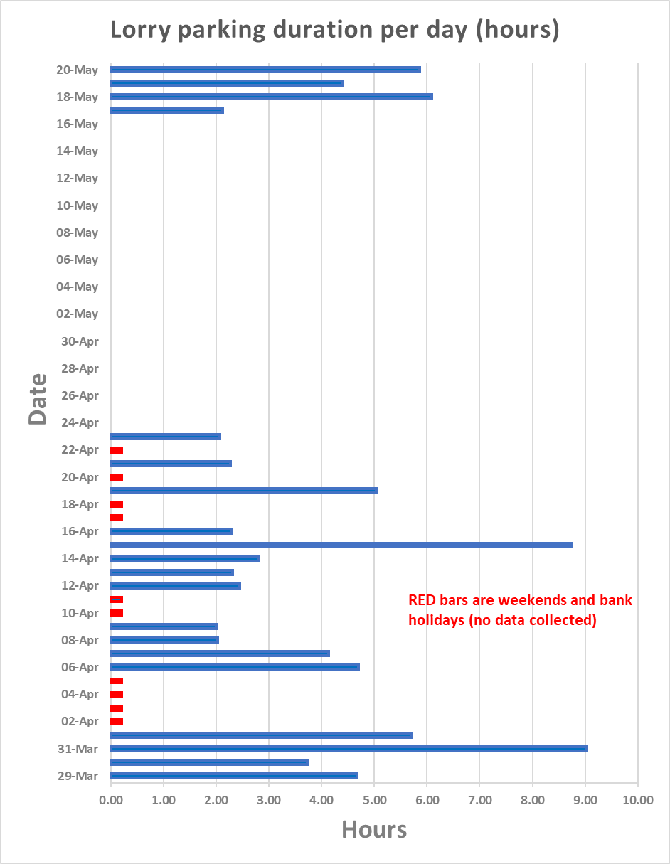
Lorry data collected by the Owner Mar/Apr/May
Analyzed by Jim Stevens

Slide 25
Lorry data collected by the Owner Mar/Apr/May
Analyzed by Jim Stevens

Slide 26
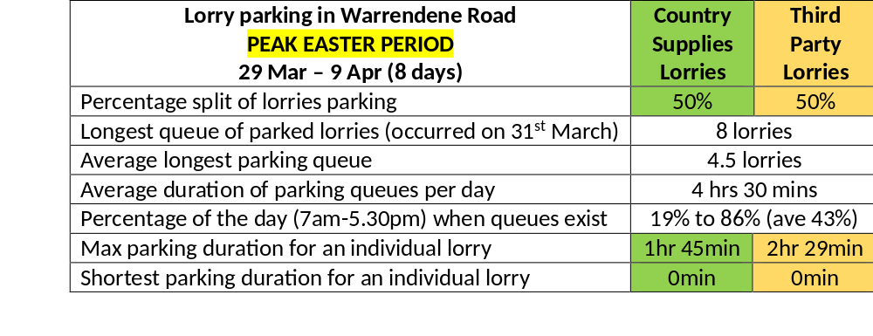
Lorry data collected by the Owner Mar/Apr/May
Analyzed by Jim Stevens

Slide 27
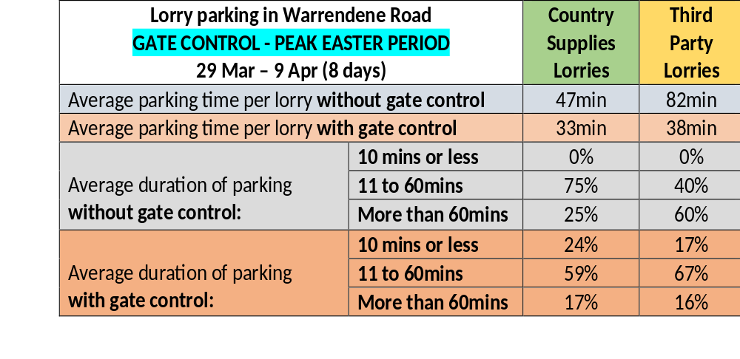
The outcome of the Gate Control Action:

Slide 28
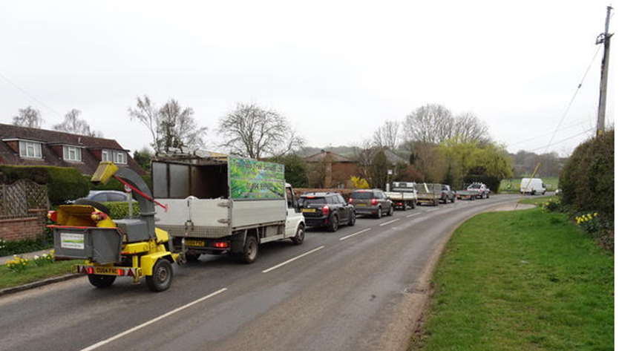
The unintended consequence of controlling the gate

Slide 29
  The Goods Vehicle Operators License (GVOL)
Authorizes 13 vehicles and 2 trailers at each site (Shana and Oakleaf)
Owner keeps 6 lorries Shana and 8 at Oakleaf – therefore is compliant with GVOL
Three Conditions govern ‘Authorized Vehicles’ at Oakleaf:
  Time/day restrictions on operation, movement, loading or unloading
  ‘Exit right’ out of site and return in same direction (i.e. No left turn out of site)
  Emergency maintenance for legal road use only

Slide 30
Actual wording of the GVOL Conditions
There will be no operation, movement, loading or unloading of authorised vehicles or trailers at the operating centre before 06:30 hours and after 19:00 Mondays to Fridays; before 08:00 and after 13:00 on Saturdays; and there shall be no operation, movement, loading or unloading of authorised vehicles or trailers at the operating centre on Sundays and Public Holidays.
Vehicles authorised under this licence will exit the operating centre by a right-hand turn and return by the same direction.
There will be no maintenance (other than emergency steps to regain legality for use on the road) within the operating centre of vehicles and trailers authorised under this licence.

Slide 31
Compliance with the GVOL:
Owner places great emphasis on compliance with GVOL
Conditions 1 and 3: No evidence to suggest non – compliance
Condition 2: Owner does occasionally send authorized vehicles left out of site for local deliveries to nearby villages (e.g. Hampden) as this is less disruptive than turning right out of site.
  Owner said he will cease doing this if necessary
  Needs properly assessing and is included as an Action in the proposed Package of Measures

Slide 32
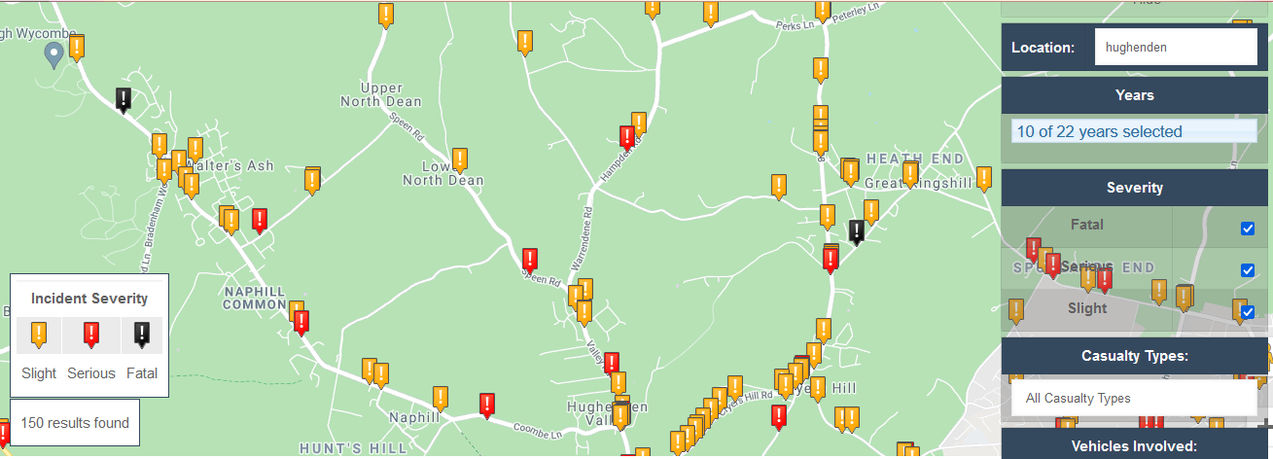
Road Safety:
Warrendene Road - no injury crashes in past 10 years
Does not mean that resident’s concerns are invalid - risks still exist
Addressing residents concerns have been a priority throughout the work carried out.

Slide 33
  Ideas discussed: (white: for consideration, black: ruled out, yellow provisional)
Relocation away from Hughenden (owner not planning to do this and cannot be forced)
Widen the access road into Oakleaf Farm to allow two-way traffic (would impact on neighbor and Right of Way, not feasible due to power lines)
Build a new access road into the site off Bryants Bottom Road and small customer parking area.
Improve the control and scheduling of deliveries, including identifying possible suitable locations elsewhere that lorry drivers could wait if arriving early.
Build a layby for lorries in Warrendene Road (would address road safety concerns only)
Reorganize the storage of materials and parking / turning arrangements (Owner has already optimized the site layout, but further optimization may be possible with new access)
Install double yellow lines along Warrendene Road (would displace the lorry parking into Valley Road and other locations).
Install yellow lines at the cross roads (might be required if the ‘Gate Control Action’ is reintroduced
Install white painted boxes/lines across driveways to discourage obstruction.
Install markers or small signs to encourage better parking discipline.
Prepare a lorry drivers protocol/instruction/advice sheet and issue to all drivers and third-party hauliers to encourage a more neighborly presence in Warrendene Road.
Hold a twice-yearly meeting with the Owner, local residents and the Parish Council to exchange views and foster better neighbor relations

Slide 34
Reactions to the list of ideas:
The Key parties:
  Support in principle to all ideas
Buckinghamshire Council Local Members
  Reserved their comments/views and subject to residents views
Hughenden Valley Residents Association
  Meeting held on 7th September 2021
  Report findings presented to HVRS
  Major objection to new access and customer parking spaces

Slide 35
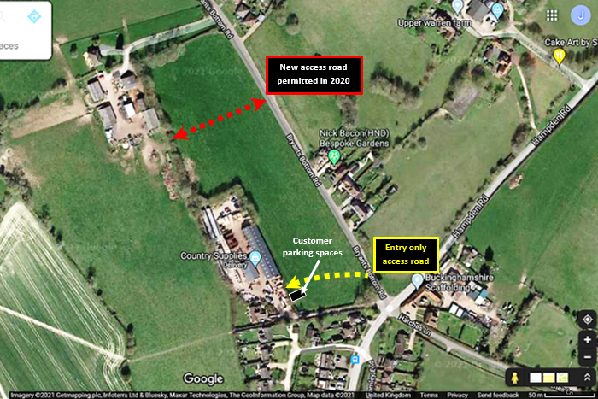
2 lane – Entry Only
  One lane for lorries
  One lane for customers
Could accommodate up to 6 lorries parking
Existing access – Exit Only
Would require planning permission
Green Belt Policy exists
Would require tree and planting screening.
Is within third party land
Improvement to Bryants Bottom Road necessary

Slide 36
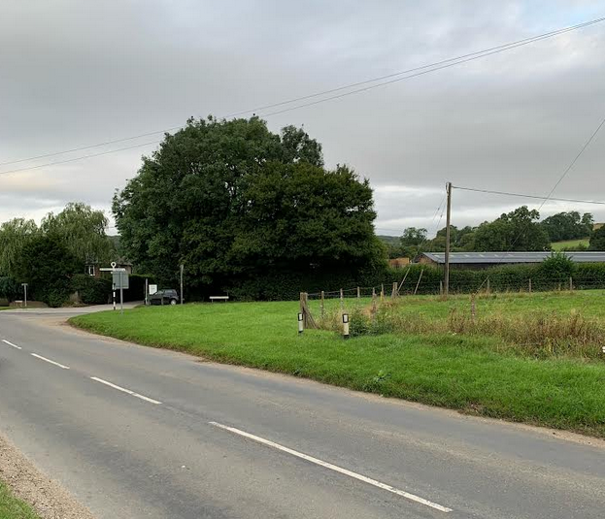
Approx position of proposed access

Slide 37
Major objection from HVRA:
Concerned that a new access road and customer parking spaces would:
Lead to an expansion of the Country Supplies business and intensification of lorry traffic and more lorry parking.
Create a car and lorry park in the field, in the Green Belt/AONB.
Damage the countryside, hedges, habitat, rural outlook and views.
Create road safety risks and highway operational problems at the cross roads and in Bryants Bottom Road.

Slide 38
The suggested way forward:
Two Key Objectives:
  To Reduce lorry parking demand
  To Foster good relations between residents, Country Supplies and lorry drivers
    Both Objectives - supported by specific Actions
    Seem to have a consensus of support
A third Key Objective?:
  A new access into the site, customer parking spaces
    Would accommodate lorry parking and customer parking that would otherwise occur on Warrendene Road
    Is very controversial and objected to by HVRA

Slide 39
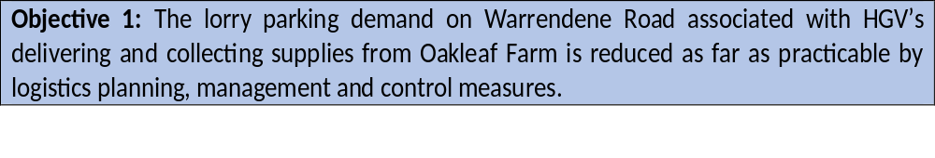
Key Objective 1
Appears to have a consensus of support from the key parties:

Slide 40
Ideas that could support Objective 1:
Lorry Logistics: Identify and implement all opportunities to plan, manage and control lorries to and from Oakleaf Farm to reduce parking demand (and very early morning arrivals) on Warrendene Road.
Alternative parking locations: Identify possible suitable locations for lorries to wait in the wider area and incorporated these into the logistic planning for Country Supplies own fleet and also the driver’s protocol for third party hauliers.
Gate Control and Sharna Artic Actions: Review the acceptability of re-introducing the gate control action and Shana artic action, given the unintended consequences described in this report.
Condition 2 GVOL: Consider whether full compliance with the GVOL right turn Condition 2 out of Oakleaf Farm is necessary form a Highways perspective.
An implied Action: Ensure any operational actions or changes associated with the ideas that are eventually agreed at Oakleaf Farm do not have an adverse impact on the Shana site (and vice versa).

Slide 41
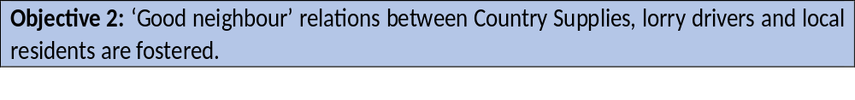
Key Objective 2
Appears to have a consensus of support from the key parties:

Slide 42
Ideas that could support Objective 2:
Lorry Drivers: Produce a lorry drivers’ protocol (instruction/advice sheet) and issue to all drivers and third-party hauliers to encourage a more neighborly presence in Warrendene Road.
Local meetings: Hold a twice-yearly meeting with the Owner, local residents and the Parish Council to collaborate on implementing the Package of Measures.
White Lines and marker posts: Consider installing white painted boxes/lines on Warrendene Road across driveways to discourage obstruction and the installation of marker posts and encourage better parking discipline.
Yellow Lines: Consider installing short lengths of double yellow lines in the immediate vicinity of Bryants Bottom Cross Roads to aid free movement of traffic and enhance road safety.

Slide 43
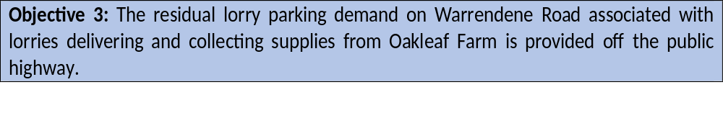
The third Key Objective that was discussed, but is very controversial:
New access road: A new 2 lane ‘entry only’ access road is provided into the Oakleaf Farm from Bryants Bottom Road to enable lorries and customer vehicles to access the site and wait, if necessary, off the public highway.
Existing access: The existing access road is restricted to an ‘exit only’ for all vehicles.
Customer parking: A small customer car parking area is provided next to the existing yard to facilitate maneuvering of lorries through the yard area

Slide 44
Next Steps:
NWCCB to discuss the finding and ideas in the report
4 Recommendations are made to the Community Board this evening:

Slide 45
Four Recommendations to the Community Board:
NOTE the extent of the work that has been undertaken to investigate the lorry parking issues raised by the residents, the engagement with key parties, including a wider group of residents, all of which have informed the findings of this report.
REJECT the resident’s request, as described in their Petition, due to the adverse implications this would have for the local community in Walters Ash/Naphill.
NOTE that other ideas have been identified in this report, that could be taken forward, to reduce the lorry parking problems in Warrendene Road.
COMMENT on the ideas set out in this report, including sending any comments by email to the Community Board Coordinator by 30 September 2021.
NOTE that this report and the comments made in the Community Board meeting and received by email, will help inform Buckinghamshire Council Local Members decide by 29th October 2021, the way forwards and next appropriate steps.

